Slide 1

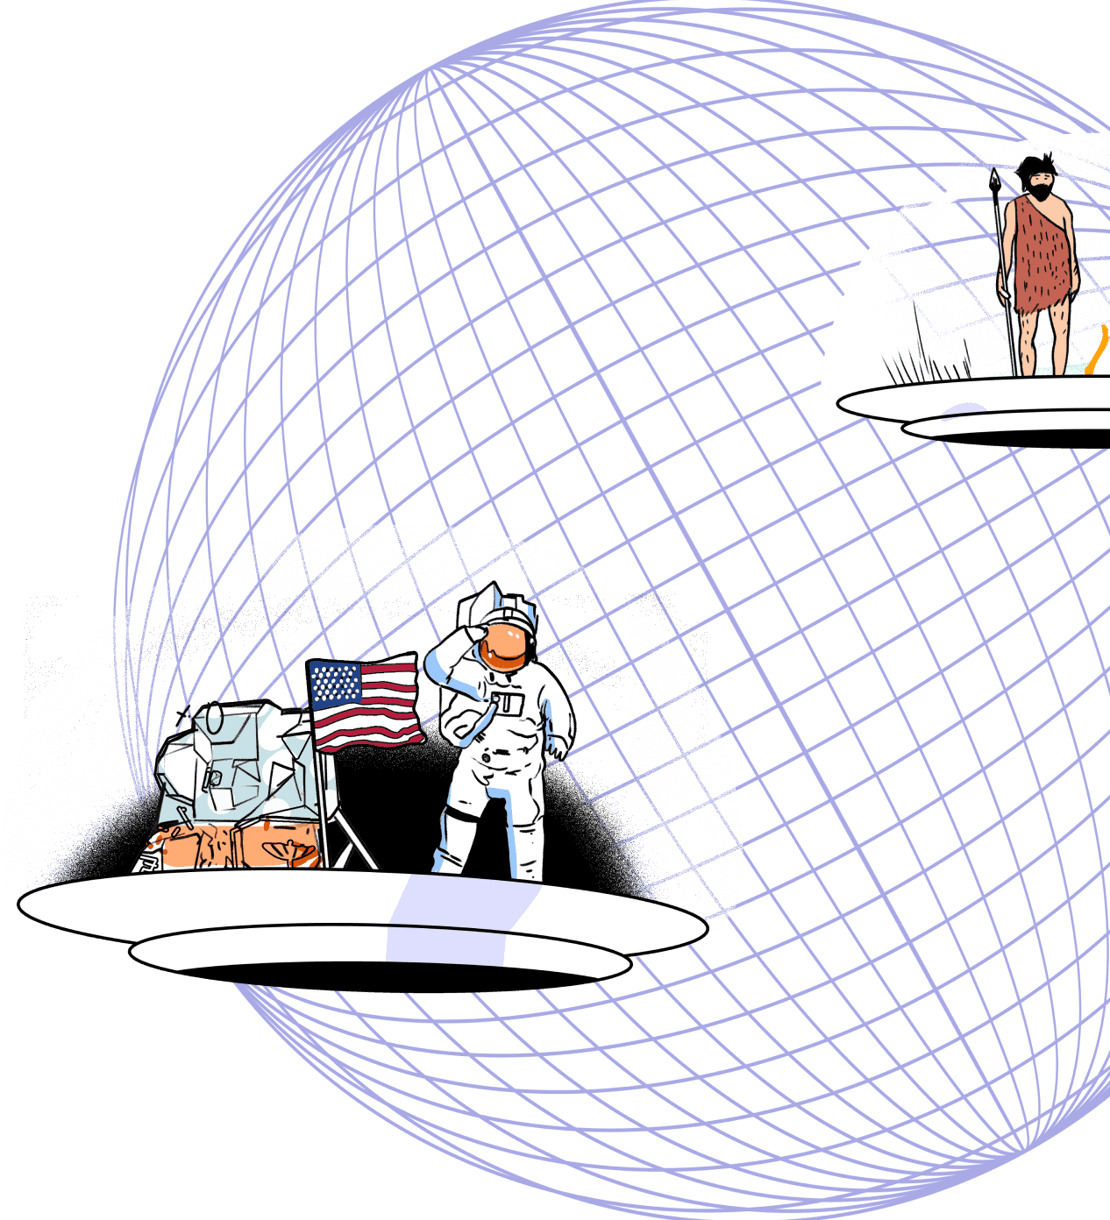

** V0.1 - Last updated 20260507 **
*Please make a copy of this deck when using for specific-client purposes
And ensure all highlighted references with a * are removed and the highlighting also
Overview for [*Client Name]
[*Month] 2026

Slide 2


Prevalent AI Overview
Company Overview
PAI is a UK / India company, founded in 2017 with 150+ employees
We deliver an AI powered Data Fabric Platform, that provides an unparalleled level of Visibility for our client environments
On top of the Data Fabric an almost unlimited set of cyber solutions can be delivered, starting with Exposure Management
Exposure Management is made up of several Modules including Attack Surface Management, Risk Based Vulnerability Management, and Continuous Controls Monitoring
Our Data Fabric and Knowledge Graph enables “Navigator”, the most accurate Generative AI Assistant for cyber
Clients use our Data Fabric for a wide range of use cases, including SIEM enhancement/replacement, Threat Hunting, Insider Threat……
Our clients are typically large Enterprises (largest customer is 500k FTE)
Long-term, high-value client relationships, 0% attrition
What Differentiates PAI …
Data Fabric that provides unmatched visibility for complex enterprise environments
Integration of multiple cyber products for complete Exposure Management
Proven in the most complex environments, delivering outstanding customer loyalty
Founders with two decades of unparalleled security data
science expertise and proven success

Slide 3



The Challenge
Fragmented tooling, poor data quality, and legacy approaches leave security teams and management exposed – unable to monitor, prioritize, or act effectively
Fragmented Tooling & Growing Complexity
Enterprises often rely on 100+ cybersecurity tools spread across disconnected environments, and isolated from non-cyber tools. This creates data silos, duplicative workflows, and operational blind spots – overwhelming security teams and preventing a unified view of enterprise risk for executives
Poor Data Quality Undermines AI Effectiveness AI depends on high-quality datasets. However, most cybersecurity data is incomplete, inconsistent, and duplicative. Without clean, contextualized data, AI-driven initiatives produce inaccurate and unreliable results. Knowledge and Context Graphs are critical enablers.
Legacy Tooling Falls Short
Traditional Exposure Management tools operate reactively and lack the context needed to prioritize real risks. GRC tools rely on untimely and unreliable manual attestations. Without a data-driven unified view of assets, controls, and threats, security teams struggle with inefficient remediation, and management lack a consistent and reliable view of their control, risk, and compliance posture

Slide 4




Unifies Fragmented Cybersecurity Environments
Prevalent AI’s Data Fabric can consolidate data from more than 100 disparate cybersecurity tools and enterprise solutions into a unified, entity-resolved platform, eliminating silos and blind spots across the enterprise
The Solution
Prevalent AI consolidates signals across the stack into a contextualized data fabric that enables visibility into system integrity and operational resilience, and unleashes AI-powered operations
Delivers Clean, Contextualized Data
By cleansing, deduplicating, and normalizing data, Prevalent AI ensures trustworthy, structured inputs, solving the “garbage in, garbage out” dilemma and enabling reliable AI and analytics outcomes
Enables Continuous Exposure Management
Through continuous mapping of assets, controls, and threats, Prevalent AI’s Exposure Management modules provide a contextual, up-to-date view of enterprise risk across hybrid environments
Knowledge Graph for Ultimate Query Flexibility
The Knowledge Graph architecture transforms data into an enterprise-wide source of truth, enabling fast, flexible querying for investigation, compliance, and decision-making
Supports Cyber Operations with GenAI
Prevalent AI’s generative AI-powered assistant, and advanced threat correlation turn raw security data into actionable insights

Slide 5
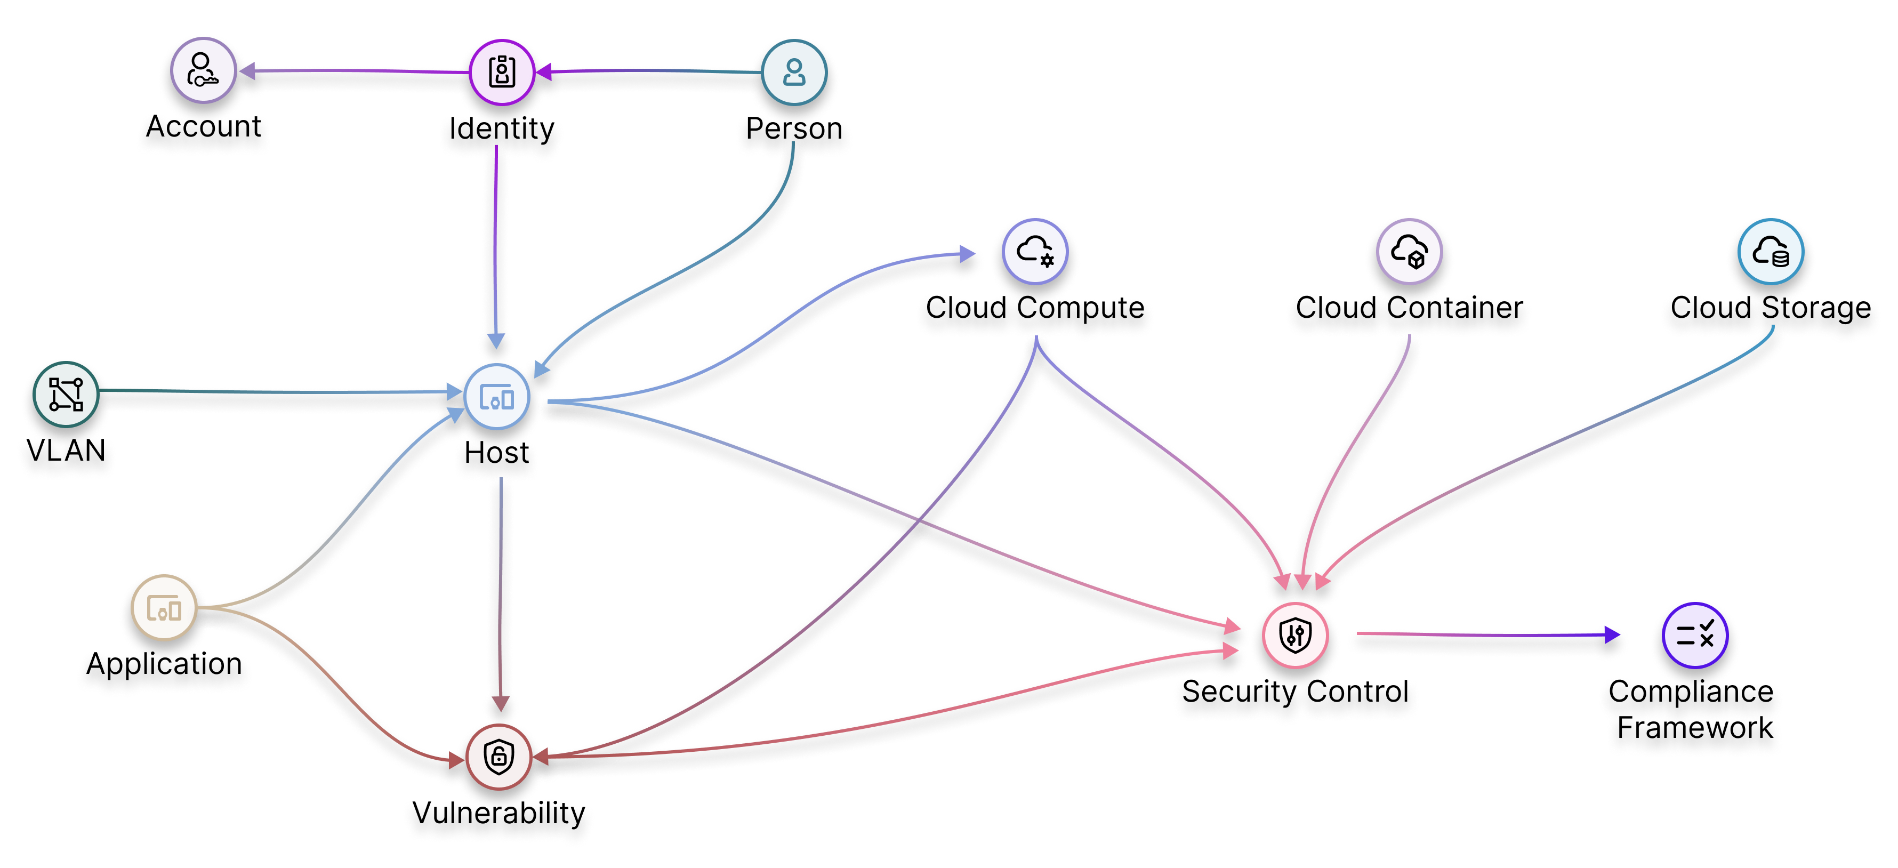

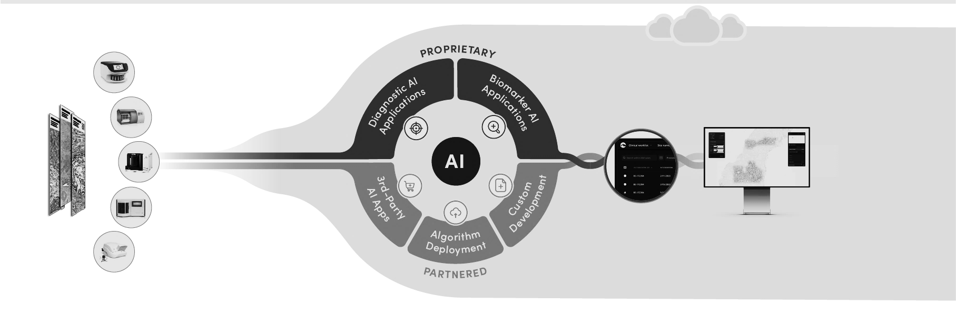

VARIANT
Platform Foundation
Purpose-Built Data Fabric Powering Cyber Resilience at Scale
Acquire
Consolidate
Graph
Data Bridge
Data Bridge enables integration across 100+ tools, connecting assets and data from any source, cloud or on-prem, with speed and simplicity. Cyber and non-cyber data is unified, to provide rich business context and enable monitoring and reporting of controls across domains and against multiple regulatory and compliance requirements
Entity Resolution
Prevalent AI delivers accurate, dependable asset intelligence by discovering and enriching assets directly from raw source data. It standardizes disparate formats using a rich ontology, de-duplicates and correlates records to eliminate redundancy and resolves conflicts to create a unified view of every asset, laying the groundwork for reliable AI-driven analysis
Knowledge Graph
At the core of Prevalent AI’s platform, the Knowledge Graph dynamically maps the enterprise environment, enabling deep, contextual queries on assets and security posture. It powers advanced use cases and functions as the authoritative data layer for enterprise AI

Slide 6































Platform Foundation
100+ Integrations Deliver a Single Source of Truth
Cloud
NDR
Vulnerability Management
APPSEC
VPN
ERP
IAM
MDM
CMDM
DataBridge
Data Warehouse
EDR
DDI
PAM
Client Data Source
Knowledge Graph
Custom Data Source
No Code Integration
Configure, don’t code: Integrations within DataBridge require zero custom development. Everything is handled through simple UI-based configurations—eliminating the need for engineering effort and making setup quick and repeatable.
Schema-Agnostic Design
Adapts to source changes automatically: Traditional integrations break with schema changes. DataBridge uses a schema-less ingestion approach, automatically accommodating evolving data structures without manual intervention—ensuring seamless continuity.
Common Integration Patterns
Connect sources quickly and reliably: DataBridge supports secure API-based pulls for SaaS tools, file/log ingestion for batch exports and telemetry, direct cloud account integrations (AWS/Azure/GCP) using least-privilege access, and Jira/ServiceNow workflows to create and track remediation—keeping status and evidence aligned end to end.

Slide 7




Platform Overview
Automated Entity Resolution
VARIANT
Knowledge Graph
Prevalent AI’s Entity Resolution Module automatically discovers, standardizes, correlates and enriches asset data to transform fragmented source inputs into a unified, accurate and dependable asset inventory
The Knowledge Graph provides the contextual backbone of Prevalent AI’s platform, enabling real-time insight across assets, vulnerabilities, identities, and controls at scale
Entity Extraction
Automatically identifies and maps entities from varied data sources using GenAI, primary key detection, and delta-based processing
Normalization
Standardizes inconsistent formats and values through rule-based logic, machine learning, and DAG-based expression evaluation
Resolution
Resolves complex entity relationships using candidate key identification, GraphX-powered graph algorithms, and exception handling
Compresses one terabyte of raw data into 50 gigabytes of high-performance graph, modeling millions of nodes and edges
Proven to scale across billions of records and over 100 data pipelines, delivering deep, continuous insights
Supports flexible modeling that evolves quickly without full data reloads
Drives dynamic risk scoring, advanced analytics, and GenAI with a unified, trusted data layer
Merge
Creates a single source of truth by merging attributes, auditing entities, and maintaining versioned snapshots with resolvers

Slide 8























Technology Architecture
Platform Overview
Cloud/On-Prem
```
Managed Services
Asset Visibility & CMDB | Identity Visibility | CTEM | CCM | Insider Risk | Cyber Gen-AI Assistant
Data Fabric
Knowledge Graph
Entity Resolution
Studio
Data lake
Data Bridge
Containerized
Data Sources
(Representative Sample)
`
Endpoint Management
VM
EDR/AV
Cloud
CMDB
HR
IAM/IGA
Existing Data Stores

Slide 9
Platform Hosting
Deployment Models
Flexible deployment models designed for security, control, and scalability
Prevalent Hosted
Hybrid Hosted
Client Hosted
Single-tenant SaaS
Single-tenant SaaS + BYOS
Client Cloud
PREVALENT CLOUD
PREVALENT CLOUD
CLIENT CLOUD
Exposure Management
Exposure Management *
Exposure Management
Big Data Processing
Big Data Processing *
Big Data Processing
Graph Engine
Graph Engine *
Graph Engine
Data Lake (Raw + KG)
Secure Connection
Data Lake (Raw + KG)
CLIENT CLOUD
Data Lake (Raw + KG)
* Transient, meta data and cache data are stored in Prevalent Cloud

Slide 10


AI-Driven Exposure Management for Proactive Risk Mitigation
Unify cyber risk signals across the enterprise – delivering a smarter, faster, and far more scalable way to manage exposure
1
DISCOVER
Complete visibility and context, across all attack surfaces
ASSESS
Identify, consolidate and contextualize findings across vulnerabilities and control weaknesses
1
2
2
Exposure Management
3
PRIORITIZE
Not all risks are created equal. Focus on the findings that matter
4
3
4
REMEDIATE & REPORT
Accelerate fixes, stop attacks before they happen, automate reporting of posture and compliance

Slide 11





Exposure Management Capabilities
Integrated Platform Addressing Mission-Critical Domains
Prevalent AI’s Exposure Management offering integrates key cybersecurity use cases into a single platform, simplifying complex security landscapes and maximizing value
Cyber Attack Surface Management (CAASM)
Gain real-time visibility into digital assets, identify and mitigate vulnerabilities rapidly, and strengthen security posture to reduce cyber risk
Risk Based Vulnerability Management (RBVM)
Prioritize and contextualize vulnerabilities based on potential impact and exploitability, allocating resources to address the most critical risks first
CAASM
CCM
RBVM
Identity Security Posture Management (ISPM)
Monitor access, permissions, and authentication to proactively address privileges and dormant accounts, reducing the risk of identity-based attacks
Continuous Controls Monitoring (CCM)
Measure control performance across infrastructure, identify gaps and risks, and make data-driven adjustments for optimal protection
CSPM
ISPM
Cloud Security Posture Management (CPSM)
Gain control over multi-cloud environments, detecting misconfigurations, violations, and security gaps to remediate risks and enforce policies

Slide 12
Executive Summary
The Proposal at a Glance
The Challenge
Fragmented tooling, poor data quality, and legacy approaches leave security teams unable to monitor, prioritize, or act effectively across the enterprise.
Our Approach
Prevalent AI unifies signals through a purpose-built data fabric with entity resolution and a knowledge graph, enabling AI-powered exposure management at scale.
Proposed Engagement
A focused pilot integrating core data sources to demonstrate asset visibility, vulnerability prioritisation, and continuous controls monitoring within 90 days.
Key Pilot Outcomes
Unified asset inventory across all data sources with entity resolution
Risk-based vulnerability prioritisation beyond CVSS scoring
Continuous controls monitoring with gap and drift detection
Executive dashboards showing exposure reduction over time

Slide 13
*For Pilot to Production Proposals
Pilot to Production
Month 1
Month 2-3
Month 4+
Deployment and Data Integration
Pilot Use Case (e.g. CMDB, VM)
Production and Use Case Expansion
Key Activities
Environment Setup and Integration
Onboarding Pilot Data Sources
Exploratory Data Analysis
Key Activities
Modelling of Key Assets/Entities
Configuration of Use Cases
Dashboard Configuration
Key Activities
Pilot Use Case Transition to Production
Expanded Visibility across Domains
Additional Use Cases
Additional Data Source Onboarding
“Downstream” tool integrations
Managed Services Delivery Model
Key Activities
Pilot Phase – Typically PAI-Hosted
Production Phase – PAI-Hosted or migrated to Client Cloud
Dependencies and Assumptions
PAI typically host the Solution during the Pilot phase within a dedicated Cloud Tenant (to avoid Client infra lead-time and dependencies).
The Solution can be migrated to Client Cloud if desired post-Pilot
Client will provide access to Pilot data sources via Vendor APIs
Scope can be limited to lower-sensitivity sources and/or fields, focus on fields required for Entity Resolution, Asset Classification and Context

Slide 14
*For Pilot to Production Proposals
Pilot
Proposed Pilot Scope
2 critical Controls (VM & EDR) enable the Discovered Asset Landscape. MDM/CMDB/ITSM sources provide a device management barometer to compare against.
Domain / Use Case Set | Vuln Scanner | EDR | MDM | CMDB / ITSM | Dir. (AD/AAD) | Cloud | IdP/SSO | PAM | HR | SIEM / Logs
Asset Management / CAASM | ◐ | ◐ | ◐ | ● | ◐ | ◐ | ◐ | ◐ | ◐ | ◐
Vulnerability Management | ● | ◐ | ◐ | ◐ | ◐ | ◐ | — | ◐ | — | ◐
Continuous Controls Monitoring | ◐ | ◐ | ◐ | ◐ | ◐ | ◐ | ◐ | ◐ | ◐ | ◐
Privileged Access & Identity | — | ○ | ○ | ○ | ● | ○ | ● | ● | ● | ◐
Cloud Posture & Baselines | ○ | — | — | ○ | ○ | ● | ○ | ○ | ○ | ◐
Legend: ● Core (foundational) ◐ Enhances ○ Optional
Proposed Pilot Scope

Slide 15
*For Pilot to Production Proposals
Pilot
Proposed Pilot Scope
Stand-up an extendable Data Fabric
Implement automated daily ingestion for Pilot data sources, with lineage and data quality checks
Model and resolve Entities to create a consolidated, normalised, and trusted cross-source view; the Asset Source of Truth
Automate daily evolution of the Knowledge Graph, as a foundation for Pilot Use Cases and beyond, e.g:
CMDB reconciliation & health improvement: gap/stale/duplicate/conflicts
Unmanaged / Unknown Asset Coverage & Detection: e.g seen in EDR but not CMDB, overlap (seen in 1 / 2 / 3+ sources)
Endpoint Posture: e.g EDR and VM coverage and configuration
High-confidence vulnerability-to-asset association: resolve duplicates and bind scanner findings to the canonical asset record (with source lineage)
Exploitability-weighted prioritisation: prioritise by KEV/exploit availability + EPSS-style likelihood + severity, not CVSS alone
Exposure-aware risk scoring: boost priority for internet-facing assets, or those missing key/compensating security controls
SLA policy & tiering: different remediation SLAs by asset tier/class (workstations vs servers vs prod vs crown jewels)
Provide baseline Control Posture Dashboards for a defined subset of Controls (powerable through Pilot sources)
Enable Users to create their own Custom Interactive Dashboards

Slide 16
1
Align on Scope
Confirm pilot domains, data sources, and success criteria with key stakeholders
Next Steps
We look forward to partnering with your team to transform cybersecurity operations
2
Technical Onboarding
Connect data sources, configure entity resolution, and validate data quality
3
Pilot Execution
Deploy core use cases, iterate on dashboards, and measure initial outcomes
4
Review & Expand
Present pilot results, quantify ROI, and define production roadmap

Slide 17
Competitive Differentiation
Why Prevalent AI
01
Purpose-Built Data Fabric
Not a SIEM or data lake. Our data fabric with entity resolution and knowledge graph creates a true unified view of the enterprise, not just data aggregation.
02
AI-Native Architecture
AI is embedded in the platform core, not bolted on. Machine learning powers entity resolution, risk scoring, and anomaly detection from day one.
03
Domain Convergence
One platform spanning CAASM, RBVM, ISPM, CCM, and CSPM. Eliminates the 5+ point tools most enterprises maintain for these functions.
04
Time to Value
Pre-built connectors and automated entity resolution mean pilot results in weeks, not months. No manual data mapping or custom integration required.

Slide 18
End to end Example
“Full-Spectrum” Use Case Example
Multiple Assessments and metrics combine to provide a systemic view of Risk from either the perspective of controls, or the affected assets; we determine the impact of individual control gaps, and also consider other controls affecting the asset. We leverage an understanding of the asset’s criticality and the vulnerabilities that is has, to determine “net” Risk, taking all things into consideration
Inventorying of Software and Hardware Assets
CIS Control #1 - Knowing what you have and where it is. You get a super-set - yet normalised overview - of all assets within the estate. This is used as a baseline for a variety of additional Control Assessments. You know what you have, where it is, and how important it is. You get metrics on how many assets actually exist in your CMDBs (coverage), along with measures of how frequently and recently they have been reconciled (performance), or if the assets are dormant.
Vulnerability Management and EDR Controls
You get coverage and performance metrics on the percentage of your estate being managed by these key controls.
How many assets are being scanned? How many via the appropriate method, and at the required frequency? Are vulnerabilities being remediated i-line with Policy?
How many of my assets have an EDR agent deployed? Are they configured correctly? Are they receiving signature updates?
Systemic Risk Analysis
One can assess assets with only partial compliance. For example, assets being scanned for vulnerabilities, but not being patched appropriately. Which of these assets do not have EDR, thus exploitation of known-to-be vulnerable assets might go unnoticed? One can see which of these assets are used by privileged users, and thus where control weaknesses pose a greater problem. The fidelity and comprehensiveness of Control Assessments are unlimited, providing breadth and depth of coverage, and enabling an intelligent understanding of what and where the real problems are.

Slide 19
Asset Management / CAASM
Unified inventory, coverage, and lifecycle
Vulnerability Management
Risk-based prioritisation and remediation
Privileged Access
Identity catalogue, creep, and governance
Identity and User360
Stitching, lifecycle, and posture
Cloud Posture and Baselines
Inventory, compliance, and drift
Continuous Controls Monitoring
Coverage, health, and exception governance
Use Case Examples

Slide 20
Use Case Examples
Use Case Alignment
Use Cases could be considered as a layered concept, because the same business outcome can be expressed at different levels of granularity.
1
Solution / Domain
2
Functional / Capability
3
Measure
Broadest alignment to a capability area or business outcome
Specific functional outcomes within a domain
Granular metrics and KPIs tied to a capability
Examples
CCM
CAASM / Asset Visibility
Compliance Evidence & Reporting
Examples (within CCM)
Endpoint Posture
Identity Hygiene
Cloud Baselines
Vuln Remediation Effectiveness
Examples (within Endpoint Posture)
Coverage: EDR, Vuln Scanner, App Control
Health: EDR Health, Scan Freq., Ownership
Vulnerability: SLA Adherence, EoL OS, Passwords
Config: SCBC, Local Admin, USB Control

Slide 21
Use Case Examples
Asset Management / CAASM
Discovery & Normalisation
Coverage & Posture
Multi-source asset discovery: endpoints, servers, cloud, SaaS, network
Normalisation: common asset model (schema + value standardisation)
Entity resolution: dedupe/link with confidence + lineage
CMDB reconciliation: gap/stale/duplicate/conflict detection
Asset coverage: by source + overlap (1/2/3+ sources)
Unmanaged asset detection: e.g. in EDR but not CMDB
Endpoint posture: EDR and VM coverage and config
Tag hygiene: cloud tags: owner/env/cost
Context & Ownership
Lifecycle Management
Ownership attribution: owner/team/cost centre
Criticality scoring + tiering: crown jewels / business impact
Service/application mapping: asset to app/service to BU
Lifecycle state management: new/active/dormant/decom
Tag hygiene governance: owner/env/cost tagging coverage
Custom interactive dashboards: user-configurable views

Slide 22
Use Case Examples
Vulnerability Management
Prioritisation & Scoring
Remediation Workflow
Vuln-to-asset association: resolve duplicates, bind findings to canonical asset
Exploitability-weighted prioritisation: KEV + EPSS + severity, not CVSS alone
Business criticality weighting: elevate on crown-jewel / regulated systems
Exposure-aware risk scoring: boost for internet-facing or missing controls
SLA policy + tiering: different SLAs by asset tier/class
Remediation ownership: assign via CMDB/service mapping
Scan-to-fix-to-verify: track found, triaged, ticketed, fixed, verified
Visibility & Reporting
Coverage bias detection: report where scanning is missing/stale
Risk burn-down reporting: exposure reduction over time by service/BU/owner

Slide 23
Use Case Examples
Privileged Access
Identity & Access Catalogue
Risk Detection
Privileged identity catalogue: human/service/break-glass with ownership
Privilege concentration: who has too much access; too many admins
% privileged with strong auth: MFA/conditional access coverage
Dormant privileged accounts: ageing, last activity, revalidation
Privilege creep detection: movers accumulating access over time
Entitlement graph: groups/roles to permissions to resources (blast radius)
Governance & Hygiene
Break-glass governance: usage frequency + review status + expiry control
Service account hygiene: ownership completeness + rotation/credential age
Privileged session governance: coverage, policy compliance, and gaps

Slide 24
Use Case Examples
Identity and User360
Identity Stitching & Profiles
Lifecycle & Governance
Authoritative identity stitching: HR / IdP / directory alignment
User360 profile: person, accounts, devices, key apps/resources
Account sprawl + orphan detection: outliers with no HR-backed owner
User-to-device binding: EDR/MDM login signals with conflict detection
Joiners/movers/leavers assurance: deprovision SLA + post-termination reporting
Dormant identity hygiene: inactive users (privileged vs standard)
Guest/contractor governance: sponsorship, ageing, auto-expiry checks
Risk & Posture
Privilege exposure overview: privileged identity catalogue + concentration
Identity posture: MFA/strong-auth coverage for high-risk groups
High-risk user prioritisation: weak auth + unmanaged devices + critical access

Slide 25
Use Case Examples
Cloud Posture and Baselines
Inventory & Tagging
Compliance & Baselines
Cloud inventory: multi-account/subscription/project with normalised model
Tag hygiene governance: owner/env/cost/service tagging coverage
Orphaned resources / sprawl: no owner/no activity; growth trend
Cloud-to-service mapping: posture for resources supporting critical apps
Baseline compliance by resource type: policy evaluation at scale
Public exposure indicators: internet-facing endpoints/storage mapped to owners
Identity-to-cloud access risk: overprivileged / broad roles
Drift & Remediation
Drift rate tracking: new non-compliant resources per week
Time-to-fix for critical failures: SLA + ageing distribution

Slide 26
Use Case Examples
Continuous Controls Monitoring
Endpoint Controls
Vulnerability & Patch
Control coverage map: by asset tier (what should be present vs what is)
EDR coverage + health: installed, reporting, policy applied, up-to-date
MDM coverage + compliance: enrolment, encryption, device hygiene
Encryption coverage: endpoints/servers where measurable + exceptions
Local admin / privilege exposure: including privilege concentration
Vuln scan cadence compliance: % scanned within policy; gaps by BU/env
Patch SLA adherence: critical/high within policy; ageing distribution
Unsupported / EoL OS coverage: with remediation prioritisation
Drift & Governance
Drift detection: new assets missing baseline controls (weekly trend)
Exception governance: backlog, age, expiry proximity, repeat offenders

Slide 27
Use Case examples
Data Source Requirements
EDR/MDM + CMDB + unlock multi-domain quick wins; add Cloud / IdP / PAM / HR over time to expand fidelity and breadth of domains
Domain / Use Case Set | Vuln Scanner | EDR | MDM | CMDB / ITSM | Dir. (AD/AAD) | Cloud | IdP/SSO | PAM | HR | SIEM / Logs
Asset Management / CAASM | ◐ | ◐ | ◐ | ● | ◐ | ◐ | ◐ | ◐ | ◐ | ◐
Vulnerability Management | ● | ◐ | ◐ | ◐ | ◐ | ◐ | — | ◐ | — | ◐
Privileged Access & Identity | — | ○ | ○ | ○ | ● | ○ | ● | ● | ● | ◐
Cloud Posture & Baselines | ○ | — | — | ○ | ○ | ● | ○ | ○ | ○ | ◐
Continuous Controls Monitoring | ◐ | ◐ | ◐ | ◐ | ◐ | ◐ | ◐ | ◐ | ◐ | ◐
Legend: ● Core (foundational) ◐ Enhances ○ Optional

Slide 28

Global Payments Company – Visibility and Automation
Client Description: A publicly listed global payments provider offering payment processing, digital wallets, and online cash solutions for business and consumer transactions across various platforms. It has grown rapidly through acquisitions, resulting in a complex technology infrastructure.
Required a Digital Risk Platform to unify insights from a wide range of security technologies, as a foundation to identify and measure the performance and compliance of controls, proactively identify risks, improve cyber security and compliance posture, and reduce audit costs and resources.
Challenge
Data Fabric and Knowledge Graph - establish a foundational single source of truth for assets across both on-premise and cloud environments
Consolidate data from disparate security tools and systems used globally into a single platform, enabling reconciliation across source systems
Discover and track unique assets, enriching with context about where they are, what they do, and their importance
Continuous Controls Monitoring – an automated and quantitative capability to continuously identify coverage and completeness of controls, measure control performance, and report through various industry standard frameworks (e.g NIST CSF, SCF, 800-53, SOX) to demonstrate levels of compliance and maturity
Solution
Visibility – Enhanced Identity visibility by >70%, and improved Asset visibility by 45% through application of Entity Resolution, providing a consolidated and continuously updated rich Inventory, to support a variety of use cases and stakeholders
Control - Detailed exploration of assets with failing controls, to best align control improvement activities with business processes, resource availability and alignment with strategic programmes and initiatives.
Reporting - Automation of 50% of controls so far, across five frameworks, replacing hundreds of hours of manual assessments. Including automation of SOX compliance checks for financial reporting systems.
Versatility - Instant identification and continuous measurement of areas of control improvements, in support of regulatory compliance, desire to improve security posture, and initiatives to reduce risk
Benefits

Slide 29
Global Cosmetics and Beauty Company – Data Driven Resilience and Cost reduction
Client Description: Multinational company selling cosmetics, skin care, perfume, and personal care products. With operations in over 100 countries, the client has a wide range of regulatory and other reporting requirements that were manually intensive and increasingly costly to support.
The client wished to automate the measurement and reporting of controls, with the objectives of
improving cyber resilience by moving away from periodic, manual audits for identifying control weaknesses
more accurate, real-time, automated reporting, rather than existing process of monthly reports, manually curated each time, that are out of date as soon as they are created
reducing cost by moving from a manual, people heavy audit model, to a data driven, automated and continuous process that frees risk and compliance staff to focus on higher value tasks
Challenge
Data Fabric Platform was deployed, integrating tens of data sources, alongside Continuous Controls Monitoring enabling:
improved cyber resilience through continuously monitoring the hundreds of cyber controls, to proactively identify control weaknesses before they are exploited by attackers
automated, data-driven risk reporting to the board through alignment with their risk framework and the creation of custom dashboards
continuous compliance status reporting, with the ability to filter for key compliance scopes (such as financial systems), reducing the workload on the internal audit team
Solution
Remediation of control failures now happens on a continuous basis, reducing time to remediate (TTR) from 90+ days, based on manual reports, to 7 days through near real-time monitoring and reporting, leading to significantly improved cyber resilience.
Automated, continuous, data-driven reporting has replaced point-in-time, interview based NIST maturity assessments conducted by a third-party consulting firm, removing supplier cost (saving >1m per annum)
Significantly reduced manual effort, from manual control validations via people heavy audit model, to data driven, automated and continuous monitoring, freeing up audit, risk and compliance staff
Benefits

Slide 30
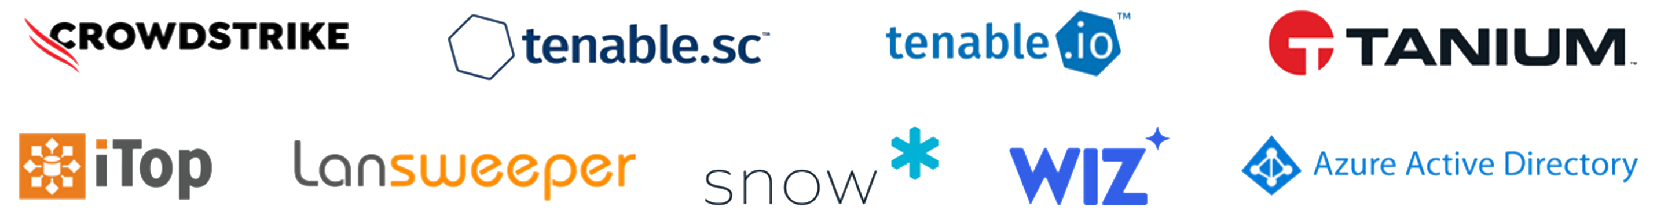
Global Outsourcing Leader – From Complexity to Visibility
Client Description: A global leader in outsourced services, employing 500,000 people, serving customers in 170 countries, and made up of approximately 20 acquisitions, creating an extremely complex cyber environment
Improving asset visibility and reducing cyber risk, hindered by the absence of a single source of truth of assets, and use of multiple tools across a complex organisational structure. Initial focus on software vulnerability risk, extending to include visibility and risk analysis of additional domains, including identity
Challenge
320 Groups, across 24 group Companies
37 Countries, across 5 Continents
Data Fabric and Knowledge Graph - establish a foundational single source of truth for assets
Consolidate data from disparate security tools and systems used globally into a single platform, enabling reconciliation across source systems
Discover and track unique assets, enriching with context about where they are, what they do, and their importance
Asset Management - assess key control coverage (like EDR, VM), and security configurations/posture of hosts
Vulnerability Risk - report exposure over time, and prioritise assets for remediation considering their criticality, software vulnerabilities, and impact of recommended fixes.
83
Unique API endpoints
Solution
Visibility – Removed >50% of duplicate assets from Inventory, from 2.7 mil down to 1.2 mil unique assets, for enhanced accuracy
Control - Identification of assets requiring additional management to bring them in-line with security standards and policies
Risk Insight – 90% reduction in Hosts with Critical Vulnerabilities to remediate, ensuring security teams focus on what matters
Exec Reporting - Global Vulnerability Risk Score across 24 companies, available instantly, previously impossible to obtain
Benefits

Slide 31
Leading International Bank – Significant Cost and Risk Reduction
Multinational bank with a significant presence in both emerging and developed markets is developing an AI powered, data driven Fusion Centre capability covering cyber security, financial crime, fraud, physical security and more. PAI is partnered with the bank on this multi-year strategic program supporting the development of advanced analytics capabilities
Cost - Existing platform (Splunk) was costing tens of millions per annum but only serving limited use cases
Performance - Existing platform struggled to support complex analytics, with high false positives and missed risks
Flexibility - Existing platform was inflexible, black box, that could only support Cyber use cases
Complexity - Transition to new platform involved huge volume, variety and velocity of data and large number of use cases involving cross business domains
Challenge
Speed and Accuracy - Leverage PAI pre-built analytics for faster time to value
Expertise - Cross functional PAI team consisting of Cyber Specialists, Data Scientists, Data Engineers and Data Architects
Partnership model - PAI team work as embedded members of the Client team
Impact measured based on 1) Cost 2) Accuracy and Risk reduction 3) Performance
Solution
Cost - 80% reduction in customer platform costs in first 12 months
Risk Reduction - Advanced analytics using Machine Learning identified previously missed Red team attacks
Performance - Analytics and searches that are easier and faster to execute eg “36 times faster to remediate credit card exposure using new platform compared to previous capability (Splunk)”
Simplification - replacing hundreds of analytics with smaller number of more accurate use cases
Benefits

Slide 32
Global Top 5 Bank – CISO Data Fabric
Client Description: Multinational bank and financial services company looking to consolidate their disparate data owned by the CISO function into a single platform, enabling predictive analytics and proactive management of risk.
The client had a vision for a comprehensive CISO Data Fabric capable of performing big data, machine learning and artificial intelligence analytics, that over time all data sources under control of the CISO function will feed into.
The Fabric needed to facilitate a data-driven approach for identifying current cyber security risks, taking a proactive approach to threat detection, performing predictive modelling, providing behavioural analytics, and threat intelligence.
The Fabric was required to be deployed in their on-premise infrastructure, ensuring compliance with their rigorous controls.
Challenge
Prevalent AI Data Fabric running on client’s existing OpenShift infrastructure including Knowledge Graph supporting extensible list of data sources.
Phased delivery over 3 years addressing tens of use cases including Security Incident Classification and Reporting, Data Security Posture Management and Risk Based Vulnerability Management.
Deep Dive – Security Incident Classification and Reporting: Use of ML and AI techniques to analyse hundreds of fields in Security Incident Tickets to normalise language in free text fields, extract key entities and classify incidents into their chosen taxonomy, automating reporting and root cause identification.
Solution
Flexible deployment model supporting client’s strict controls, allowing client to have extensible Data Fabric that would be otherwise unachievable.
Open, flexible data fabric that can be extended by client’s team and Prevalent AI services team.
Significant reduction in manual effort required to classify and analyse incidents, ability to meet new regulatory requirements on incident reporting without the need to hire additional staff.
Benefits

Slide 33
Graveyard

Slide 34
Inspo

Slide 35
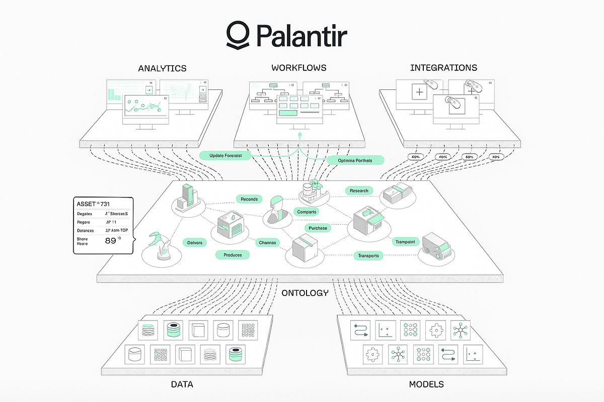
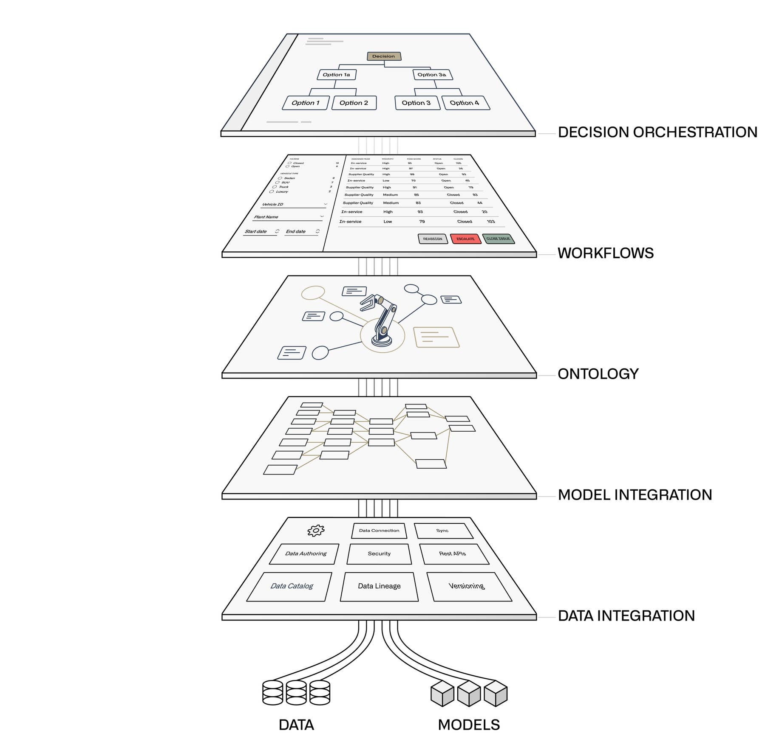

Slide 36
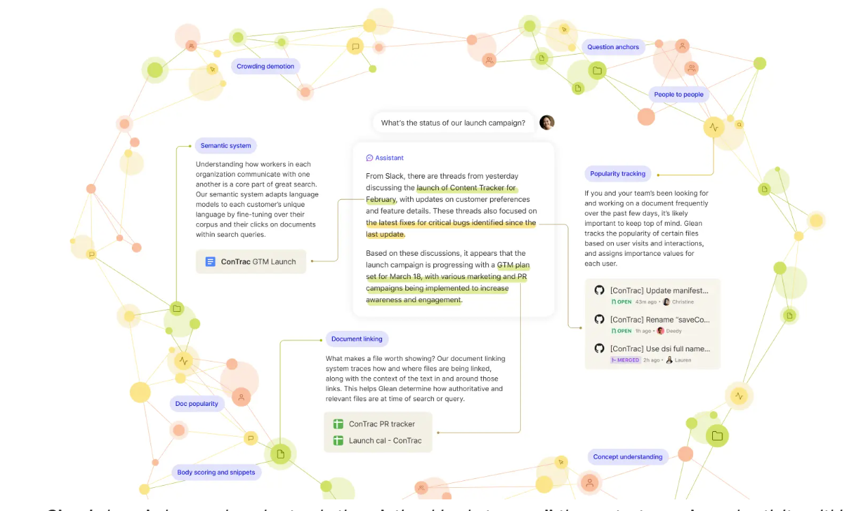
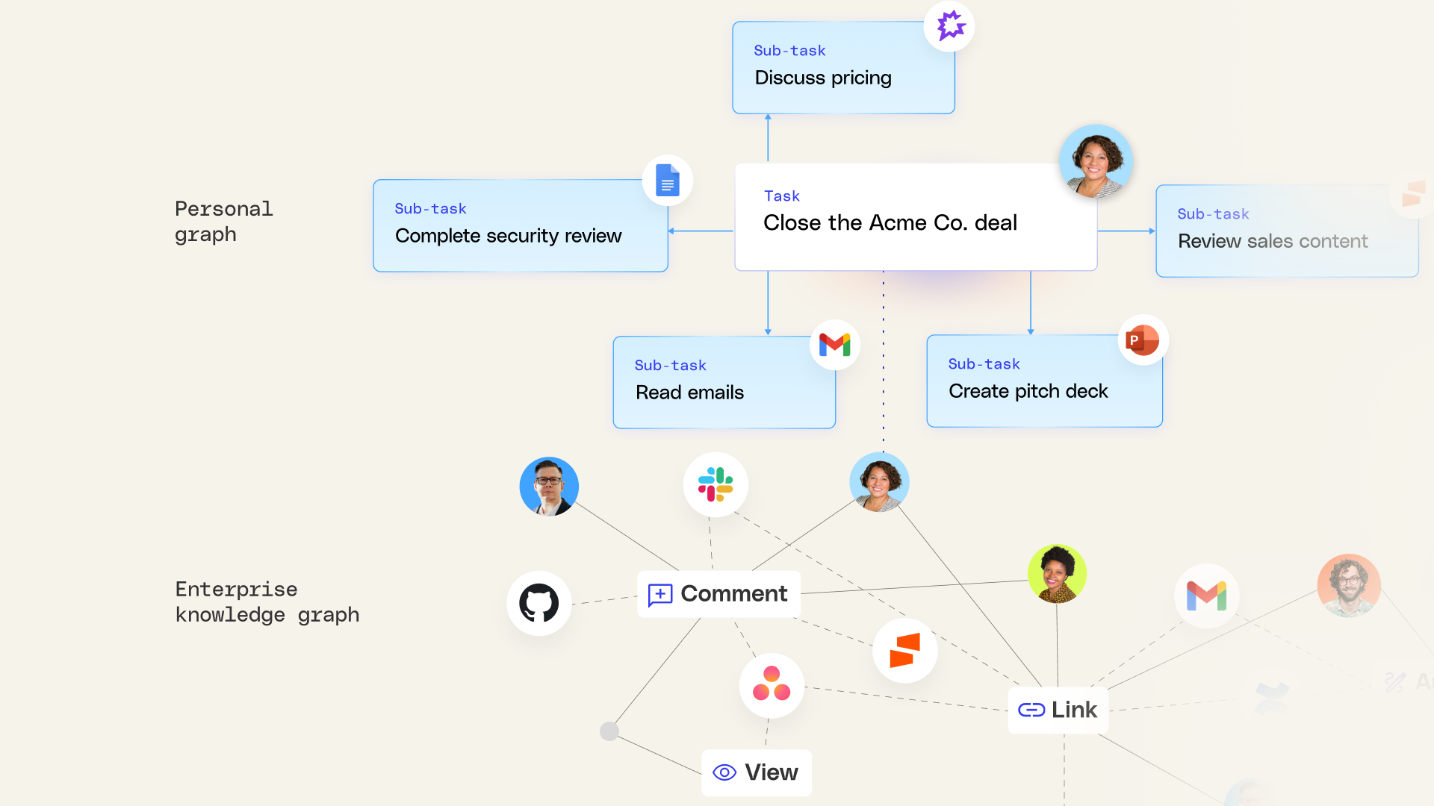

Slide 37
Other slides

Slide 38
Case Study

Slide 39
Leading International Bank – Significant Cost and Risk Reduction
A multinational bank with a significant presence in both emerging and developed markets is developing an AI-powered, data-driven Fusion Centre capability covering cyber security, financial crime, fraud, physical security and more. PAI is partnered with the bank on this multi-year strategic program supporting the development of advanced analytics capabilities
Cost - Existing platform (Splunk) was costing 10s of $millions per annum, but only serving limited use cases
Performance – Existing platform struggled to support complex analytics, with high false positives and missed risks
Flexibility - Existing platform was inflexible, a black box, that could only support Cyber use cases
Complexity – Transition to new platform involved huge volume, variety and velocity of data and a large number of use cases involving cross-business domains
Challenge
Speed and Accuracy - Leverage PAI pre-built analytics for faster time to value
Expertise – Cross-functional PAI team consisting of Cyber Specialists, Data Scientists, Data Engineers and Data Architects
Impact measured based on 1) Cost 2) Accuracy and Risk reduction 3) Performance
Solution
Cost - 85% reduction in customer platform costs in the first 12 months saving 10s of $millions
Risk Reduction - Advanced analytics using Machine Learning identified previously missed Red team attacks
Performance - Analytics and searches that are easier and faster to execute eg “36 times faster to remediate credit card exposure using new platform compared to previous capability (Splunk)”
Simplification - replacing hundreds of analytics with a smaller number of more accurate use cases
Benefits

Slide 40



One Platform for all Cyber Workloads
SIEM Vendor (e.g. Splunk)
Incident Resolution
PAI Data Fabric on Databricks
Alert Store
Exposure Management
CAASM
Detection Suite
Pre-Built Rule/ML based detections
Automated Knowledge Graph Context Enrichment
False Positive Reduction
RBVM
CCM
Remediation
Security Data Lake (Delta)
Knowledge Graph
Enterprise Gen AI Assistant
DataBridge
200+ PreBuilt Security/integrations
AI Connector Builder
Automated Entity Resolution
Entity Extraction
Normalisation
Resolution
Merge
Future
Financial Crime
IT Operations

Slide 41
PAI Data Fabric & Databricks - SIEM Cost Reduction Deep Dive
Current State: Splunk as SIEM
Proposed State: Databricks & PAI to augment Splunk as SIEM data processing
Splunk
Splunk
Incident Resolution
Events Data Ingestion
Splunk Ingestion
Pre-Processing
Alert Generation
Incident Resolution
Notables sent to Splunk with rich context from Knowledge Graph
Normalisation, Enrichment
Rule/ML based detection
Databricks + PAI Data Fabric
Alert Generation
Alert Triage
Rule/ML based detection
Context Enrichment &
False Positive Reduction
Automated context enrichment
Raw Events
Enriched Events
Manual Search for context
Security Data Lake (Delta)
Knowledge Graph
Splunk Indexes
Events & Organisational
Data Ingestion
DataBridge
Normalisation, Correlation, Resolution, Enrichment
Entity Resolution
Splunk
Databricks Compute Clusters
Unity Catalog
Mosaic AI
DB
PAI
Challenges
Entire Data (Raw & enriched events) in Splunk => Huge Storage Cost
Ingestion based pricing => High License cost
Large Number of False Positives => Wasted Effort
Lack of context => Very High Investigation & Resolution time.
Advantages compared to current state
High volume data in cheap data lake storage. Only filtered alerts stored in Splunk for Incident Review & Resolution. => Lower Storage Cost (50-80% savings)
Ingestion decoupled from Splunk => No license cost for Ingestion
Analysts look only into true positives => Huge Effort Savings (60-90% savings)
Alerts already enriched with rich context from Knowledge Graph => Low Investigation & Resolution time. (60-80% savings)
Other Advantages of approach -
Security Data Lake can be explored directly from Splunk using Databricks add-on for Splunk & with Natural Language using PAI Agentic AI
No new training needed. Analysts continue to work with notables from Splunk

Slide 42
Approach for SIEM Cost Reduction
✅ Key Focus: Shift from Splunk-Centric to Hybrid Model
Offload raw event processing from Splunk to a scalable data lake using Databricks and PAI—enabling enriched, filtered alerts to be sent back for triage, reducing cost and improving efficiency
Current State:
All raw + enriched data stored in Splunk
High storage & compute costs
No context available with alert => Manual context gathering
High false positives
Limitation on using advanced analytics
Proposed State:
Raw data ingested into Databricks Delta Lake via PAI DataBridge.
Alerts generated using Databricks + PAI AI
Knowledge Graph + Entity Resolution for rich context
Filtered, enriched alerts & advanced analytical insights sent to Splunk to support existing SOC workflows
Analytics to support a range of cyber use cases beyond SIEM Cost Reduction (eg CTEM, CAASM, CSPM)
Key Benefits:
💰 Cost
Up to 85% lower storage & compute costs
Fixed License fee, not dependent on ingestion volume
🧠 Analyst Efficiency
60–90% effort savings by providing rich context to the alerts, as well as providing advanced analytical insights
Focus on true positives
⚡ Advanced Capabilities & Faster Resolution
Alerts pre-enriched with context
Auto triage
Wider Cyber Coverage (outside of SIEM Incident Response)
🔌 Seamless Adoption
No retraining required
Analysts can work with enriched alerts in Splunk UI

Slide 43
AI within the Platform

Slide 44






AI in Data Fabric
Data Bridge
Entity Resolution
Navigator
AnyConnect
Entity Extraction
Normalisation
Resolution
Merge
Navigator uses Large Language Models combined with agentic architecture and proprietary algorithms in automating manual tasks as well as in extracting relevant content or translating complex queries into knowledge graph representations.
AnyConnect Uses a combination of LLMs and proprietary algorithms to search for public documentations of vendor tools and auto-generate integrations
A variety of techniques to automate various stages of the Knowledge Graph build process
Machine Learning
Text Processing
Stat modelling & Gen AI
Supervised learning on labeled data to predict target attributes, scaled with high-performance algorithms like XGBoost and lightweight language models
Fuzzy matching algorithms to extract entity information from raw text and normalize it into a consistent format across the knowledge graph.
Combination of Statistical modelling and Generative AI used to identify candidate keys for matching and merging disjoint entities via the graph algorithm.
Ingestion
Data Quality
Statistical pattern-based outlier detection and frequency-based models optimized for high-volume data, enabling efficient identification of Data Quality issues across large data without compromising performance.

Slide 45







Navigator - Functional Architecture
All within the Client Cloud Provider or Infrastructure
Natural Language Prompt
Foundational
Models
LangChain
Framework
Knowledge Graph Traversal and Retrieval
User Insights
Beyond Fine Tuning: A smarter alternative
Faster Deployment
AI Models adopted immediately
Fine Tuned Models takes time to train for each customer
Platform Independence
Works with any cloud provider / on-prem, customer data never leaves their environment
Fine tuning is often tied to specific platforms, require sending sensitive data
Cost Efficiency
Our approach has no expensive training compute cost
Fine tuning cost significant training cost
Model Agnostic Future Proofing
New AI model can be switched in days
For Fine tuned approach- this process should start from scratch
This highlights the decision-making process driven by the use case, guiding the choice between RAG and Agentic approaches.
Use Case-Driven Inferencing Layer
Our Differentiator
Universal Translator
Knowledge Graph = Translator
Knowledge Graph combines all security tools into a unified view
No Data Exposure
AI never sees raw customer data
Only uses structure (schema) from the Knowledge Graph
No Model Training Needed
Navigator translates it on the fly
Fully schema driven query generation
Dynamic Data Handling
Any additions in customer data flow through schema
No manual rework needed
RAG using Vector Databases
Agents with Cyber Knowledge Graph Metadata
Prompt Engineered Models

Slide 46
Post-session Questions
Differentiators / Competitors
We don’t believe there is a direct competitor in cyber for our Platform + Managed Services approach, based on several differentiators:
We take a Data Fabric and Knowledge Graph-based Platform approach
The Platform enables an almost unlimited set of Cyber Use Cases (Solutions)
The Knowledge Graph provides a context-rich “golden source” that’s a key enabler for Agentic workflows
We wrap a Managed Service around the Platform, that provides each Client with a customised solution to their unique model. We call this delivery approach “Build with” - giving Clients the advantages of both traditional buy and build approaches
The closest comparison outside of Cyber is Palantir: a pre-built core infrastructure layer, configurable use cases, and an expert team to tailor and extend.
Within Cyber, if you map by Solution area, we’re most often compared against Panaseer (CCM), Axonius and JupiterOne (CAASM), and Nucleus Security and XM Cyber (RBVM / exposure analysis).

Slide 47
Knowledge Graph
How a Knowledge Graph simplifies it
Easily adapt the model by adding nodes and edges, without foreign keys or complex reloads
Traversals & aggregations on terabyte-scale volumes across multiple entities have latencies of <5s.
Allows independent pipelines for fixing parts of the graph without needing a full re-computation
Key Challenges
Flexibility: Adapting to new threats, domains and technologies
Performance and scalability: Performance on millions of nodes and edges
Quality: Variety, incompleteness & inconsistency across diverse data sources
Typical client Metrics
> 5M nodes & > 30M edges in the knowledge graph
> 1B records considering history
>100 data pipelines monitored for failures
> 20 data sources into a single entity (largest entity tested on 54 data sources)
> 1000 attributes across all entities and relationships
1TB of raw volume reduced to ~50GB in the graph
Notes:
We won't go into the technical details on this slide, but the network diagram illustrates how we use a graph to maintain all the relationships between the assets; be that a laptop that is issued to an employee, a cloud resource hosting a workload, or the vulnerabilities and controls affecting servers within a datacentre.
The Graph allows us to rapidly evolve and enhance the model of your environments, and enables you to answer complex queries about your assets and the security posture of your estate.
The Knowledge Graph is the foundation of all our solutions, and can be used directly to support multiple other use cases

Slide 48
Exposure Management

Slide 49


Traditional Vulnerability Management cannot keep up
Limitations of traditional VM tools:
Limited attack surface visibility –> if you can’t see it, you can’t secure it
Blind to control weaknesses -> only seeing half the picture
Minimal context -> limits prioritisation, leads to “whack a mole”
No remediation capability -> problems without solutions
35000
30000
25000
20000
New CVEs
15000
10000
5000
0
1990
1995
2000
2005
2010
2015
2020
Date

Slide 50

Exposure Management – Consolidating related cyber solutions
CAASM Cyber Asset Attack Surface Management
CAASM
RBVM Risk Based Vulnerability Management
ASCA
RBVM
ISPM Identity Security Posture Management
CSPM Cloud Security Posture Management
CSPM
ISPM
ASCA Automated Security Control Assessment
Exposure Management

Slide 51

Prevalent AI Exposure Management Process
DISCOVER
(Complete Visibility and Context, across all Attack Surfaces)
1
REMEDIATE & REPORT
(Accelerate fixes, stop attacks before they happen, automate reporting of posture)
4
EXPOSURE MANAGEMENT
2
ASSESS
(Identify, consolidate and contextualise findings across vulnerabilities and control weaknesses)
3
PRIORITISE
(Not all risks are created equal. Focus on the findings that matter)

Slide 52


Data Fabric Powered Exposure Management
Democratise data access and exploration
GEN AI ASSISTANT
Exposure Management
Execute the most impactful campaigns, automate reporting of posture
Device Exposure
Cloud Exposure
Identity Exposure
Application Exposure
Data Exposure*
REMEDIATE AND REPORT
Prioritise Findings based on their overall contribution to Exposure
PRIORITISE
Identify, consolidate and contextualise findings, focus on what matters
ASSESS
Full visibility and context across all attack surfaces
DISCOVER
Data Fabric
A consolidated data model of your estate
Devices
Cloud
Identity
Application
Data
Vulnerabilities
Other Entities
Knowledge Graph
Environment and Data Agnostic Ingestion, Transformation and Storage
Integrations
Entity Resolution
Data Generation
Analytics
Risk Scoring
d
Data Platform

Slide 53
ADD FINDING STRUCTURE FOR SCORING

Slide 54
Delivery Model

Slide 55
Typical Delivery Approach
~ 3 Months to initial release
Discovery
Assess priority requirements/problems to solve
Platform Delivery
Provision Environment
Product Configuration
Configure Products
Provide ongoing support
Tailor Analytics
Identify existing tools and data
Ingest Data
Consider technical and operational environments
Data Integration
Connect to Sources
Deploy Platform
Integrate Platform
Model, Normalise, Resolve
~ 1-2 Months (largely client dependent)
~ 2 Months onwards (dependent on breadth of data sources)
Problems
I have
Data
I have
Start Here

Slide 56
Case Studies

